Slide 1
Aesthetic of User Experience Session #02
Course : GAME6012/ User Experiences
Effective Period : September 2017

Slide 2
Learning Objectives

Slide 3
Why Aesthetics?
For starters, aesthetics include everything that appeals to the senses—not just what we see, but also what we hear, smell, taste, and feel. As user experience designers, we must consider every stimulus that might influence user interaction. In the digital realm, this includes visual design, motion, sound, and even haptic (tactile) responses. perhaps more importantly, “aesthetics examines our response to an object or phenomenon” (according to Wikipedia).
In other words, aesthetics aren’t just about the artistic merit of Web buttons or other visual effects, but about how people respond to these elements. The question becomes: How do aesthetic design choices influence understanding and emotions, and how do understanding and emotions influence behavior?

Slide 4
Easily understandable
Cognition is the process of knowing. Based on patterns and experiences, we learn how to understand the world around us: What happens if i push that? What does this color suggest? Cognitive science studies how people know things, and aesthetics play a critical role in cognitive processing.

Slide 5
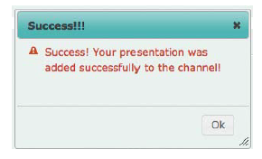
Easily understandable
What’s weird in the image?

Slide 6
Easily understandable
Great Example

Slide 7

Attractive
When We talk about affect, we’re talking about feelings and emotions. In marketing, feelings are often reduced to “I feel positive about your brand.” here, however, we consider the ways in which feelings and emotions can influence perceived and actual usability.
Which button attract you more?

Slide 8
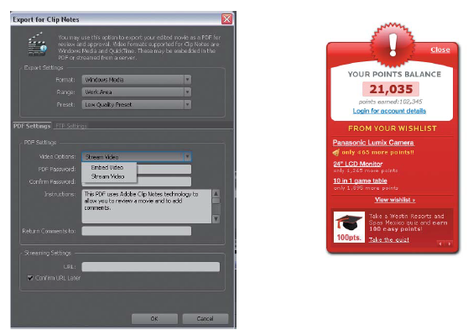
Attractive
What is user interface trying to say?
Casual
PRO

Slide 9
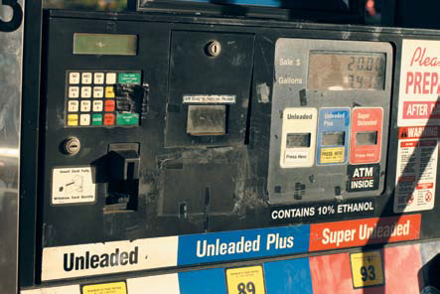
Attractive
Which one you trust?

Slide 10
Attractive
Perceptions of Progress
“…something that takes longer but that is perceived to be efficient is superior to something that is shorter but perceived differently.”

Slide 11
Associations
in truth, we make cognitive as well as emotional associations with just about everything processed by our brain. But, there’s enough to be said specifically about aesthetic associations that we should discuss this dimension separately from cognition and affect.
Compare another button

Slide 12
Associations
What is apple trying to say?

Slide 13
Associations
What is apple trying to say?

Slide 14
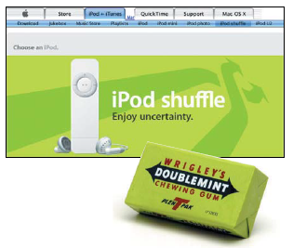
Associations
What about this one?

Slide 15
Associations
Scissors?

Slide 16
Associations
Familiar Faces?

Slide 17
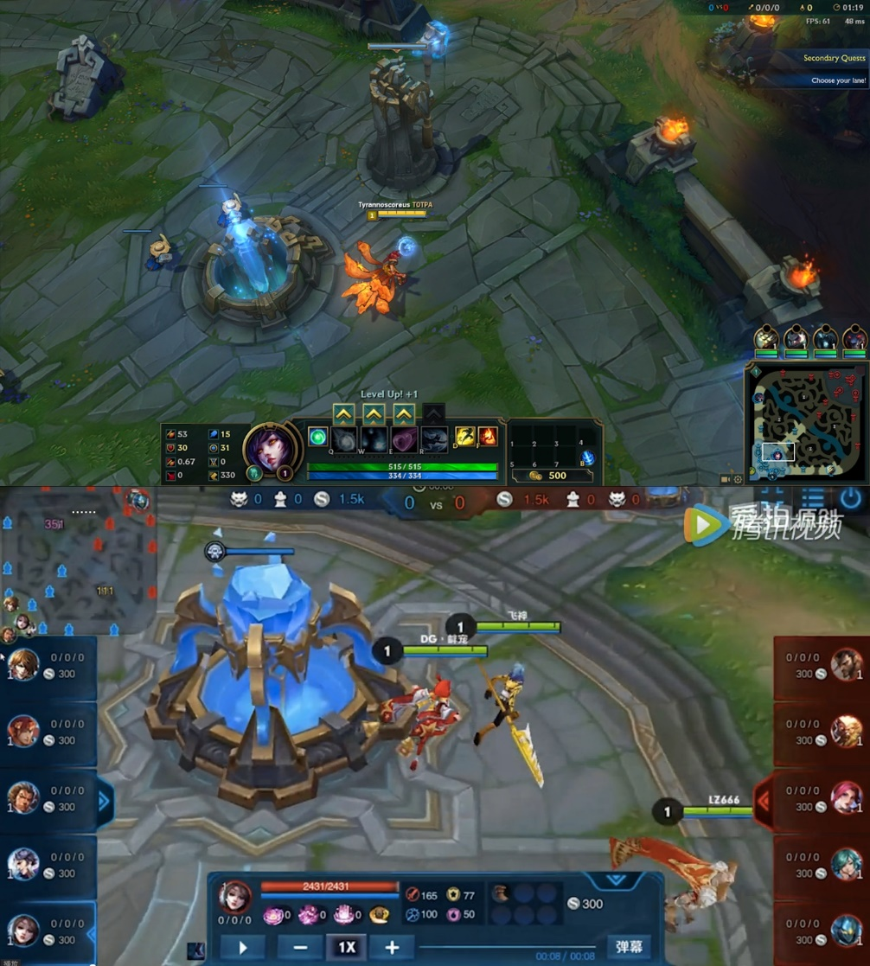
Case study
LOL vs King of Glory

Slide 18
Assignment
Search for a good clone game
What the game copied from the original game?
What differentiate between the game and the original game?
What’s improved from the original game?

Slide 19
References
Buxton, William. 2007. Sketching user experience. Elsevier
Anderson, Stephen. 2011. Seductive Interaction Design. New Riders.
Faranello, Scott. 2016. Practical UX Design. Packt Publishing

